Slide 1
SEPM – Unit V
Week 6 - Schedule
Factors Affecting Software Maintenance
Software Maintenance Team
Osborne Model of Software Maintenance
Iterative Enhancement Model
The Reuse-Oriented Model
CASE STUDY

Slide 2
Factors Affecting Software Maintenance
Relationship of Software product and environments:- the software product changes according to the organizational and operational environment.
Relationship of the software product and user :- the software product is modified according to the new user requirements.
Relationship of software product and the software maintenance team:- the software maintenance team members act as mediators to keep track of the software product.

Slide 3
Factors Affecting Software Maintenance
User Requirements :-
Maintenance Process:- Changes are implemented in the software system following the software maintenance process.
Error detection and correction:- software product tends to contain some line of ' residual' errors. If these errors are uncovered at the later stage of software development, they become more expensive to fix.
Difficulty in capturing change requirements:-users may not be able to express their requirements in a form which is understood to the analyst or programmer.

Slide 4
Software Maintenance Team
A specific number of people employed to work together as a team each with the job description,
job person specification,
role,
responsibilities and duties specific to a maintenance team member according to their employment contract and provide a variety of forms of maintenance.

Slide 5
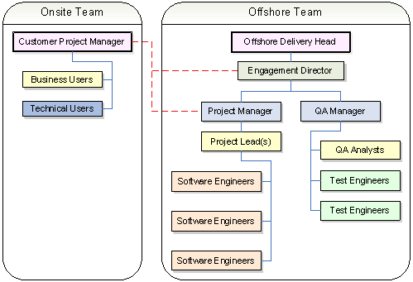
Software Maintenance Team

Slide 6
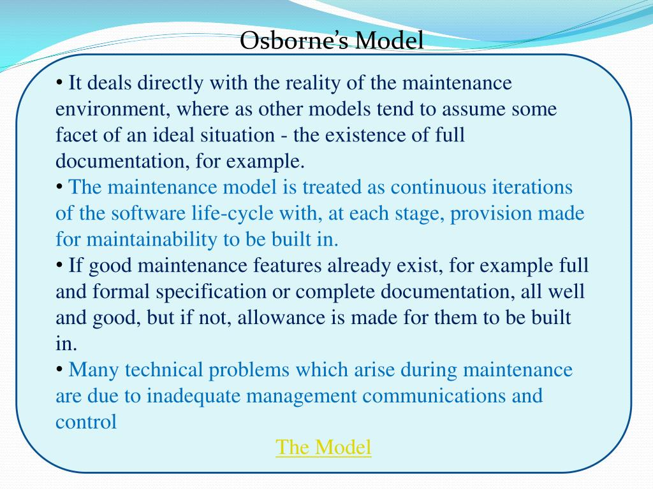
Osborne Model of Software Maintenance

Slide 7
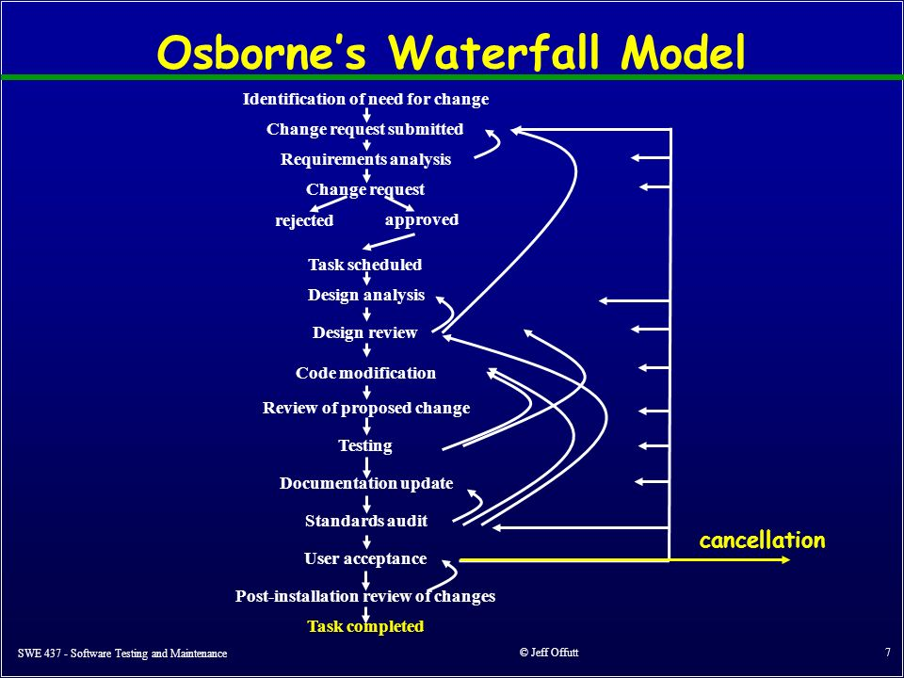
Osborne Model of Software Maintenance

Slide 8
Iterative Enhancement Model
The Iterative Enhancement Model (also known as incremental model ) comprises the features of waterfall model in an iterative manner.
The basic idea of this model is to start the process with requirements and iteratively enhance the requirements until the final software is implemented.

Slide 9
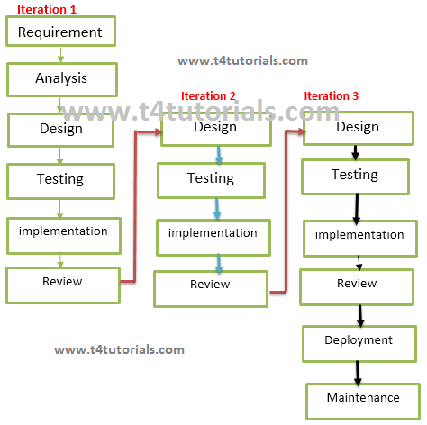
Iterative Enhancement Model

Slide 10
The Reuse-Oriented Model
The reuse-oriented model, also called reuse-oriented development (ROD), is a method of software development in which a program is refined by producing a sequence of prototypes called models,
each of which is automatically derived from the preceding one according to a sequence of defined rules.

Slide 11
The Reuse-Oriented Model
Reuse –oriented software base on reusable components and integrated framework for the composition of these components,
that components may provide specific function such as word processing and spreadsheet.

Slide 12
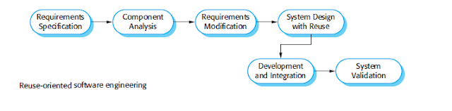
The Reuse-Oriented Model

Slide 13
The Reuse-Oriented Model
software process but other stages used in this model are different.
1. Component Analysis:- According to given requirement, component is selected to implement that requirement specification. That is not possible the selected component provide the complete functionality, but that is possible the component used provide some of the functionality required.
2. Requirement Modification:- Information about component that is selected during component analysis is used to analysis requirement specification. Requirements are modified according to available components. Requirement modification is critical then component analysis activity is reused to find relative solution.
3. System design with reuse:- During this stage the design of the system is build. Designer must consider the reused component and organize the framework. If reused component is not available then new software is develop.
4. Development and Integration:- Components and COTS system are integrated to develop new software. Integration in this model is part of development rather than separate activity.

Slide 14
The Reuse-Oriented Model
Advantages and disadvantages of reuse-oriented model:-
Advantages:-
It can reduce the overall cost of software development as compared to other model.
It can reduce the risk.
It can save the time of software development. b/c testing of component is minimize.
Faster delivery of software.
Disadvantages:-
Reuse-oriented model is not always practical in its pure form.
Compromises in Requirement may lead to a system that does not meet the real requirement of the user.
Organization using the reusable component, are not able to control the new version of component, this may lead to lost control over the system evolution.

Slide 15
CASE STUDY
A case study is a research method to gain a better understanding of a subject or process. Case studies involve in-depth research into a given subject, in order to understand it’s functionality and successes.
Mostly importantly: case studies are stories. In particular, business case studies tell the story of how your product or service helped a person or a company achieve their goals.
As well as being valuable marketing tools, case studies are a good way to evaluate your product as it allows you to objectively examine how others are using it. It’s also a good way to interview your customers about why they work with you.

Slide 16
CASE STUDY
Case Study Examples:-
Highlight the key take away from the case study.
Use icons to summarize information.
Use data to make concrete points.
Add direct quotes into your case study.
Use high contrast shapes and colors to draw attention to key information.
Conduct a case study by researching the company holistically.

